Slide 1
Large Scale Data Analytics

Slide 2
Outline
Big Data
Gartner Hype Cycle 2012
Large scale data processing
Visual Analytics
Chances and Challenges
Discussions

Slide 3
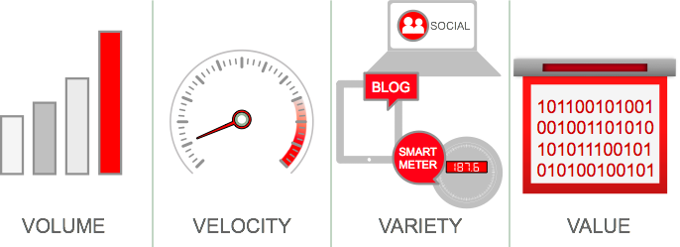
Big Data V³
Volume：Gigabyte(10⁹), Terabyte(10¹²), Petabyte(10¹⁵), Exabyte(10¹⁸), Zettabytes(10²¹)
Variety: Structured,semi-structured, unstructured; Text, image, audio, video, record
Velocity(Dynamic, sometimes time-varying)
Big Data refers to datasets that grow so large that it is difficult to capture, store, manage, share, analyze and visualize with the typical database software tools.

Slide 4

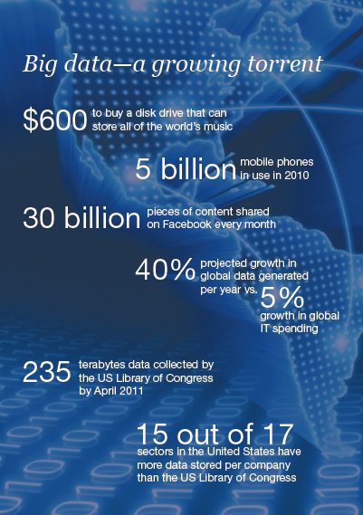
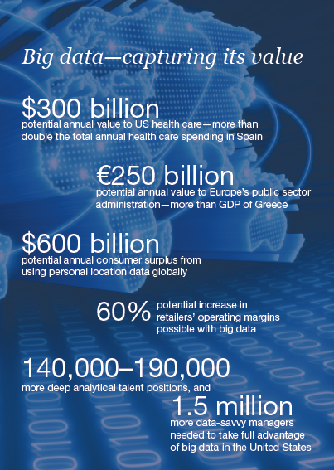
Numbers
How many data in the world?
800 Terabytes, 2000
160 Exabytes, 2006
500 Exabytes(Internet), 2009
2.7 Zettabytes, 2012
35 Zettabytes by 2020
How many data generated ONE day?
7 TB, Twitter
10 TB, Facebook
Big data: The next frontier for innovation, competition, and productivity McKinsey Global Institute 2011

Slide 5
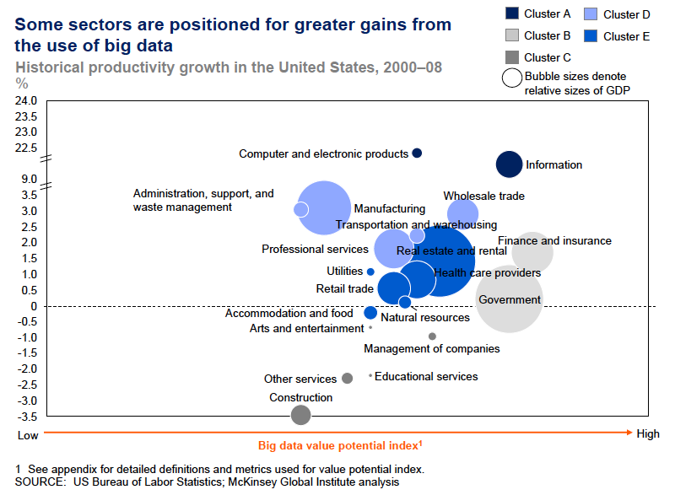
Why Is Big Data Important?

Slide 6
Data Science
Data Science is computational science of extracting meaningful insights from raw data and then effectively communicating those insights to generate value
Data Scientist
Analyzes data, particularly large amounts of data to help an organization in decision making to gain a competitive edge

Slide 7
Responsibilities of Data Scientist
Manipulation and analysis of big data
Query data (e.g. using SQL)
Prediction from big data
Visualization of big data

Slide 8
Varieties of Data
Structured: Data is stored, processed, and manipulated in a traditional Relational Database Management System (RDBMS).
Unstructured: Data that is commonly generated from human activities and doesn’t fit into a structured database format.
Semi-structured: Data doesn’t fit into a structured database system, but is none-the-less structured by tags that are useful for creating a form of order and hierarchy in the data

Slide 9
File Formats
Comma Separated Values (CSV) files
Accepted by desktop and web-based analysis application.
Also used by scripting languages such as Python and R.
Scripts
Most data scientists know how to use either the Python or R programming language to analyze and visualize data.
Script files end with the extension
.py or .ipynb (Python)
.r (R)

Slide 10
File Formats
Application Files
MS Excel is useful for quick-and-easy, spot-check analyses on small- to medium-size datasets.
Application files have the .xls or .xlsx extension.
Geospatial analysis applications such as ArcGIS and QGIS save with their own proprietary file formats (the .mxd extension for ArcGIS and the .qgs extension for QGIS)

Slide 11
File Formats
Web Programming Files
If you’re building custom, web-based data Visualizations You may be working in D3.js — or Data-Driven Documents, a JavaScript library for data visualization. When you work in D3.js, you use data to manipulate web-based documents using .html, .svg, and .css files.

Slide 12
Usage of Data Science by Subject Area Experts
Engineers use machine learning to optimize energy efficiency in modern building design.
Clinical data scientists work on the personalization of treatment plans and use healthcare informatics to predict and preempt future health problems in at-risk patients.

Slide 13
Usage of Data Science by Subject Area Experts
Marketing data scientists use logistic regression to predict and preempt customer churn (the loss or churn of customers from a product or service to that of a competitor’s).
Data journalists scrape websites (extract data in-bulk directly off the pages on a website) for fresh data in order to discover and report the latest breaking-news stories.

Slide 14
Usage of Data Science by Subject Area Experts
Data scientists in crime analysis use spatial predictive modeling to predict, preempt, and prevent criminal activities.
Data do-gooders use machine learning to classify and report vital information about disaster-affected communities for real-time decision support in humanitarian response

Slide 15
Application Areas of Data Science
Corporations, Small- and Medium-size Enterprises (SMEs), and e-commerce businesses
Production-costs optimization, sales maximization, marketing ROI increases, staff-productivity optimization, customer-churn reduction, customer lifetime-value increases, inventory requirements and sales predictions, pricing model optimization, fraud detection, collaborative filtering, recommendation engines, and logistics improvements

Slide 16
Application Areas of Data Science
Governments
Business-process and staff-productivity optimization, management decision-support enhancements, finance and budget forecasting, expenditure tracking and optimization, and fraud detection
Academia
Resource-allocation improvements, student performance-management improvements, dropout reductions, business process optimization, finance and budget forecasting, and recruitment ROI (Return on Investment) increases

Slide 17
Grappling with Data Volume
Limits of Big Data
Lower limit - 1 terabyte
No Upper limit
In its raw form, most big data is low value — in other words, the value-to-data-quantity ratio is low in raw big data
Data engineers have the job of rolling it up, and data scientists have the job of analyzing it

Slide 18
Handling Data Velocity
Big data is created through
automated processes and instrumentation
data storage costs are relatively inexpensive
In engineering terms, data velocity is
data volume per unit time
Big data enters an average system at velocities ranging between 30 kilobytes (K) per second to as much as 30 gigabytes (GB) per second

Slide 19
Data Ingestion Tools
Apache Sqoop
You can use this data transference tool to quickly transfer data back and forth between a relational data system and the Hadoop Distributed File System (HDFS) — it uses clusters of commodity servers to store big data.
HDFS makes big data handling and storage financially feasible by distributing storage tasks across clusters of inexpensive commodity servers.
HDFS is the main storage system that’s used in big data implementations.

Slide 20
Data Ingestion Tools
Apache Kafka
Kafka distributed messaging system acts as a message broker whereby messages can quickly be pushed onto, and pulled from, HDFS.
Kafka can be used to consolidate and facilitate the data calls and pushes that consumers make to and from the HDFS
Apache Flume
Flume distributed system primarily handles log and event data.
Flume can be used to transfer massive quantities of unstructured data to and from the HDFS

Slide 21
Dealing with Data Variety
Big data gets even more complicated when you add unstructured and semi-structured data to structured data sources.
Heterogeneous, high-variety data
is often composed of any combination of graph data, JSON files, XML files, social media data, structured tabular data, weblog data, and data that’s generated from click-streams.

Slide 22
Dealing with Data Variety
Structured data
can be stored, processed, and manipulated in a traditional Relational Database Management System (RDBMS).
Structured data can be generated by humans or machines, and is derived from all sorts of sources, from click-streams and web-based forms to point-of-sale transactions and sensors.

Slide 23
Dealing with Data Variety
Unstructured data
comes completely unstructured — it’s commonly generated from human activities and doesn’t fit into a structured database format.
Unstructured data could be derived from blog posts, emails, and Word documents
Semi-structured data
doesn’t fit into a structured database system, but is nonetheless structured by tags that are useful for creating a form of order and hierarchy in the data.
Semi-structured data is commonly found in databases and file systems.
It can be stored as log files, XML files, or JSON data files.

Slide 24
Data Lake
This term is used by practitioners in the big data industry to refer to a non-hierarchical data storage system that’s used to hold huge volumes of multi-structured data within a flat storage architecture.
HDFS can be used as a data lake storage repository, but you can also use the Amazon Web Services S3 platform to meet the same requirements on the cloud (the Amazon Web Services S3 platform is a cloud architecture that’s available for storing big data).

Slide 25
Large Scale Visual Analytics
Definition: Visual analytics is the science of analytical reasoning facilitated by interactive visual interfaces.
People use visual analytics tools and techniques to
Synthesize information and derive insight from massive, dynamic, ambiguous, and often conflicting data
Detect the expected and discover the unexpected
Provide timely, defensible, and understandable assessments
Communicate assessment effectively for action.

Slide 26
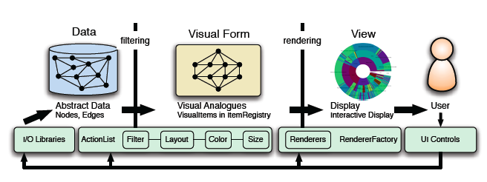
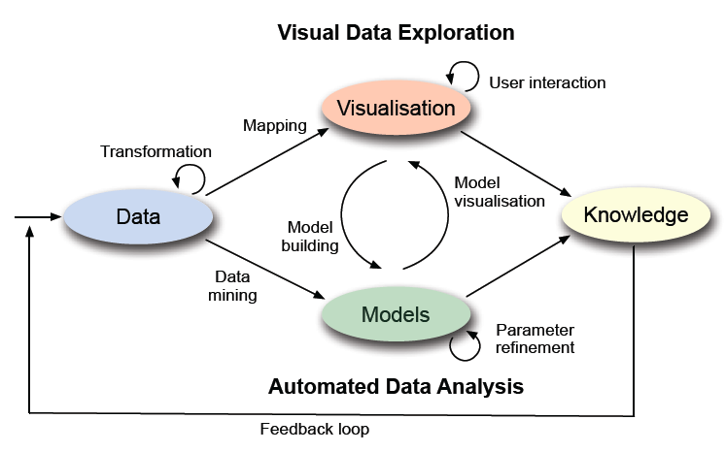
Inforviz Reference Model to Visual Analytics

Slide 27
Applications
Terrorism and Responses
Multimedia Visual Analytics
Situation Surveillance and Awareness in Investigative Analysis
Disease visual analytics for Disease outbreak Prediction
Financial Visual Analytics
Cybersecurity Visual Analytics
Visual Analytics for Investigative Analysis on Text Documents

Slide 28
Techniques and Technologies
A wide variety of techniques and technologies has been developed and adapted for
Data aggregation
Data manipulation
Data analysis
Data visualization
These techniques and technologies draw from several fields including
Statistics
Computer science
Applied mathematics
Economics.

Slide 29
Techniques and Applications
Statistics: A/B testing(split testing/bucket testing ),Spatial analysis , Predictive modeling :Regression
Machine Learning
Unsupervised learning: cluster analysis
Supervised learning: classification, support vector machines(SVM), ensemble learning
Association rule learning
Data Mining and Pattern Recognition: neural network, classification, clustering
Natural language processing(NLP): Sentiment analysis
Dimension Reduction: PCA, MDS, SVD
Data fusion and data integration： Visual Word
Time series analysis: Combination of statistics and signal processing
Simulation: Monte Carlo simulations, MRF
Optimization: Genetic algorithms
Visualization: Scientific Viz, Inforviz, Visual Analtytics

Slide 30
Technologies
Database and Data warehouse
Google File System and MapReduce: Big Table
Hadoop: HBase and MapReduce, open source Apache project
Cassandra: An open source (free) DBMS, originally developed at Facebook and now an Apache Software foundation project.
Data warehouse: ETL (extract, transform, and load) tools and business intelligence tools.
Business intelligence (BI): data warehouse, reporting, real-time management dashboards
Cloud computing: Services, SOA, etc.
Metadata: XML
Stream processing
R, SAS and SPSS
Visualization:Tag cloud,Clustergram,History flow, Themeriver, Treemap

Slide 31
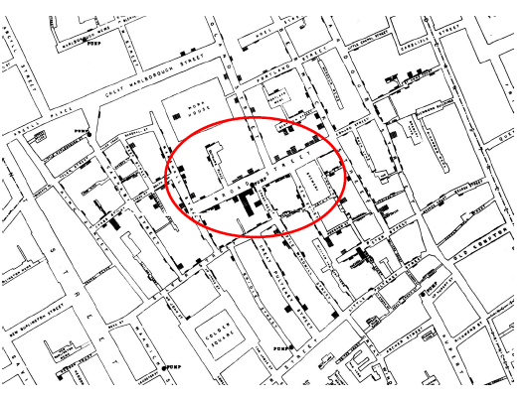
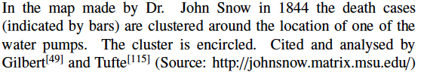
Origin of Information Visualization

Slide 32
InforViz Techniques
Scatterplot and Scatterplot Matrix
Hierarchies Visualization:Node-Link Diagrams, Sunburst,Treemap, Circle-packing layouts
Network Visualization:Force-Directed Layout,Arc Diagrams,Matrix Views
Multidimensional Visualization/Parallel Coordinates
Stacked Graphs
Flow Maps

Slide 33
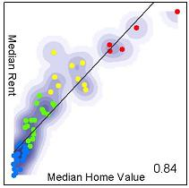
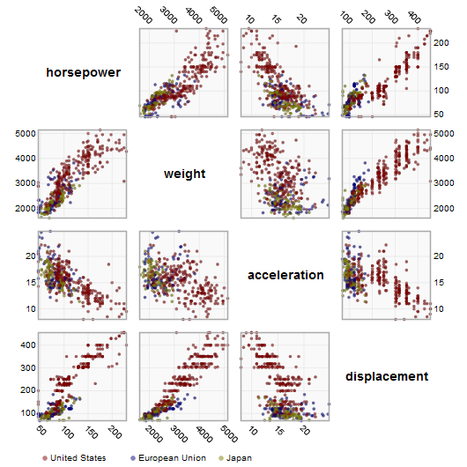
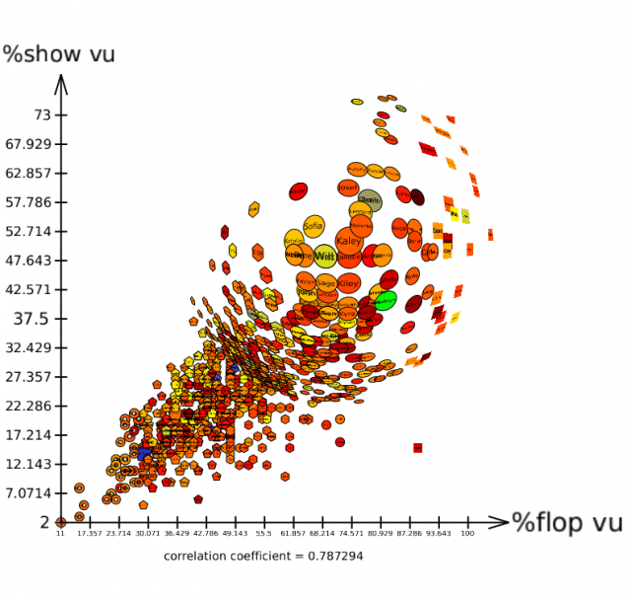
Scatterplot and Scatterplot Matrix

Slide 34
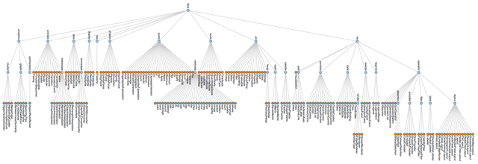
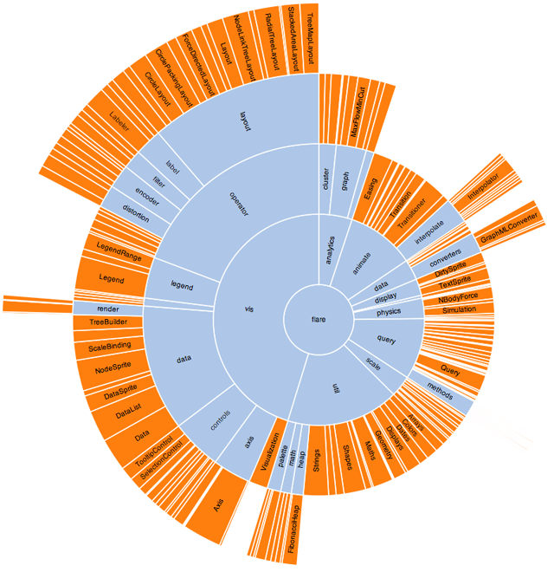
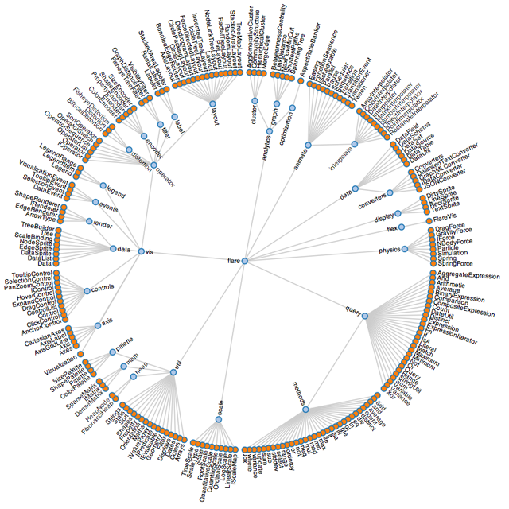
Tree Visualization(1)
Node-Link Diagrams
sunburst
Dendrogram

Slide 35
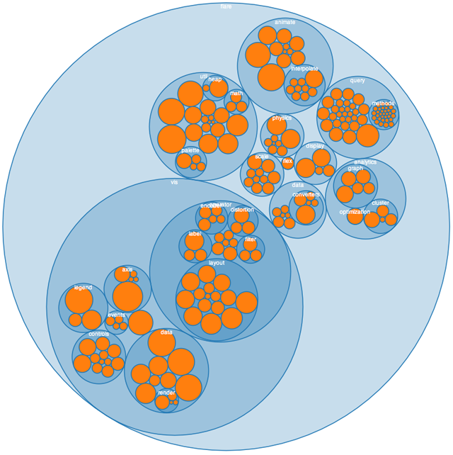
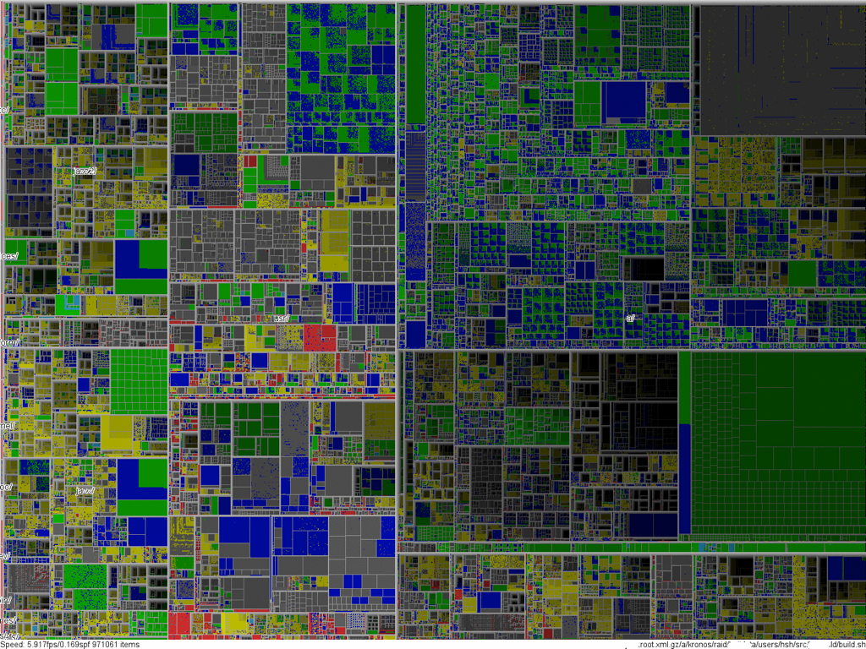
Tree Visualization(2)
Treemap
Circle-packing layouts

Slide 36
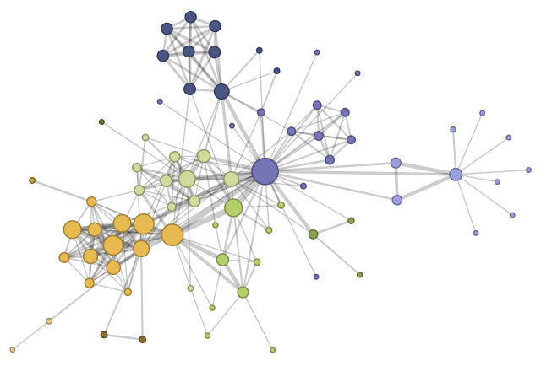
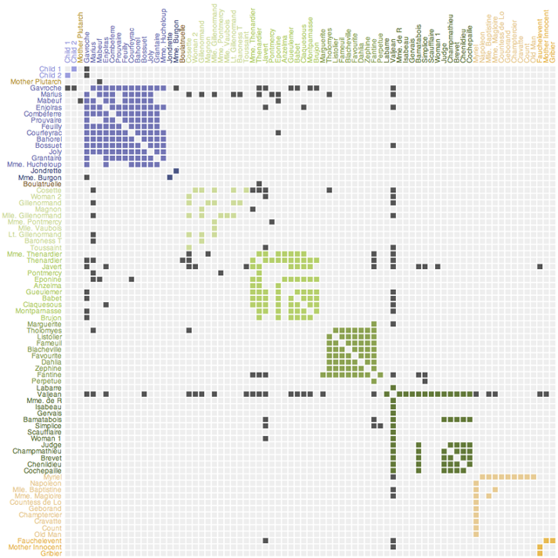
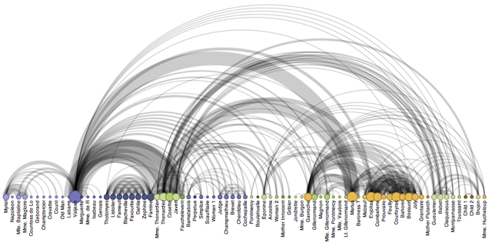

Network Visualization
Force-Directed Layout
Matrix Views
Arc Diagrams

Slide 37
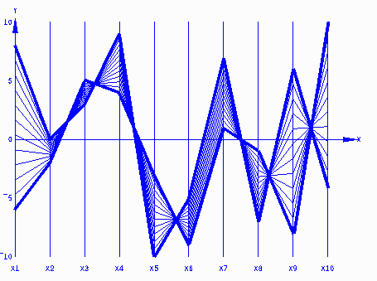
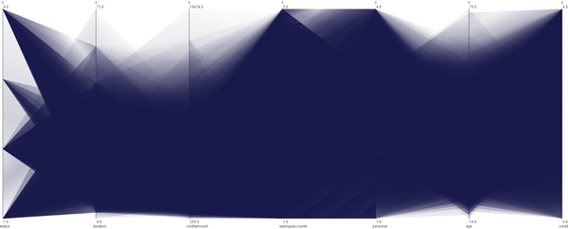
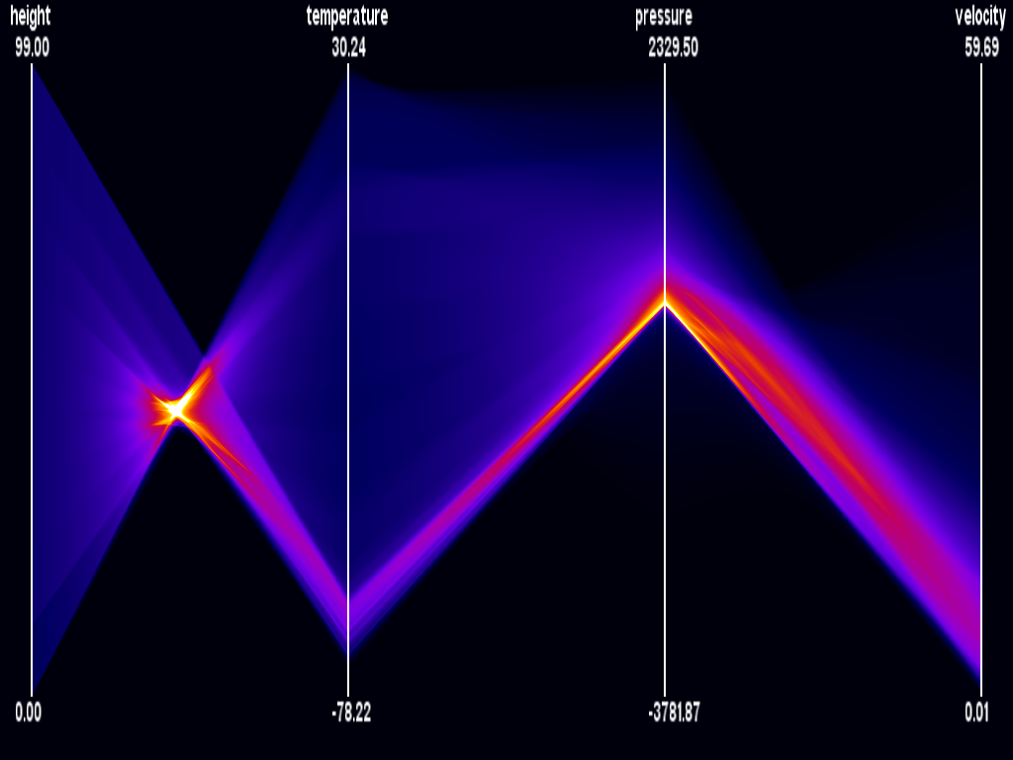
Parallel Coordinates

Slide 38
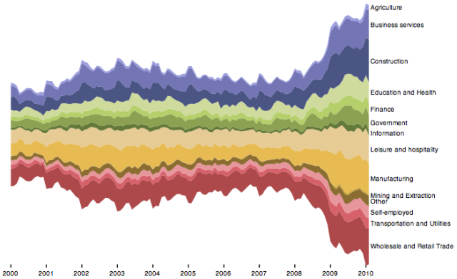
Stacked Graphs

Slide 39
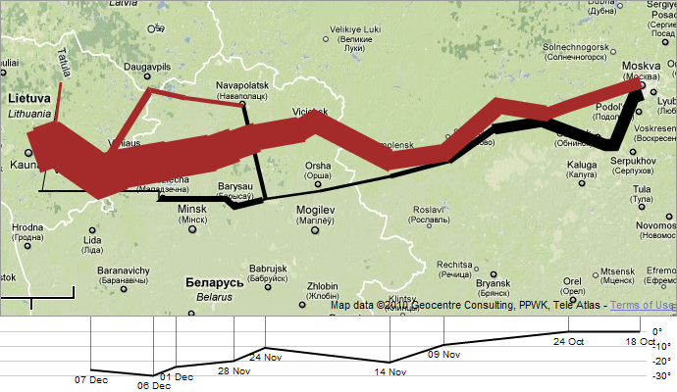
Flow Maps

Slide 40
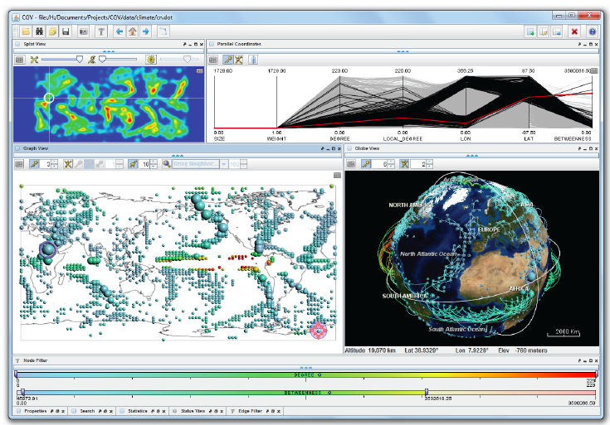
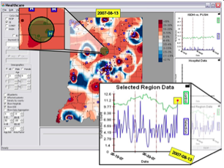
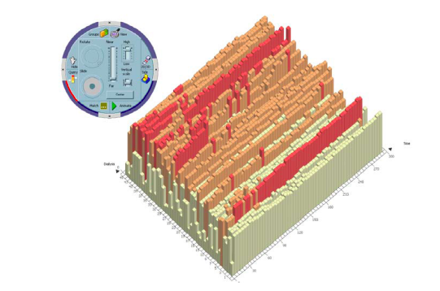
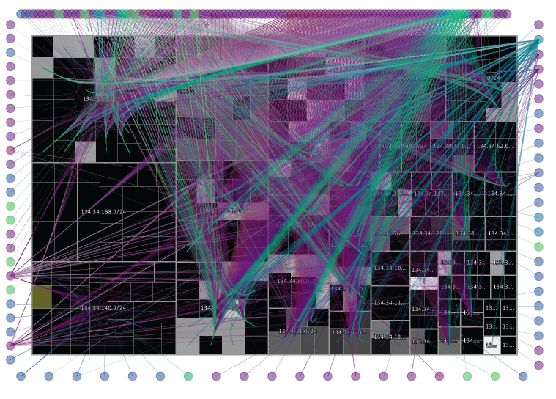
Examples

Slide 41
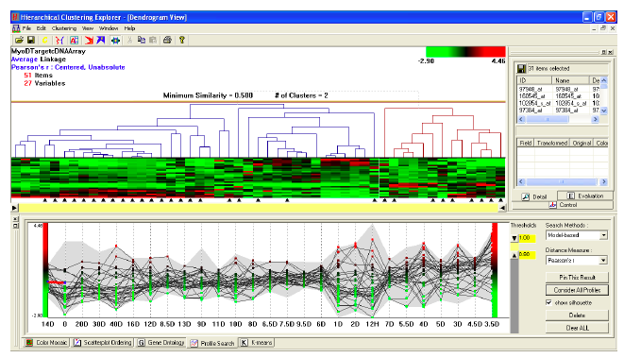
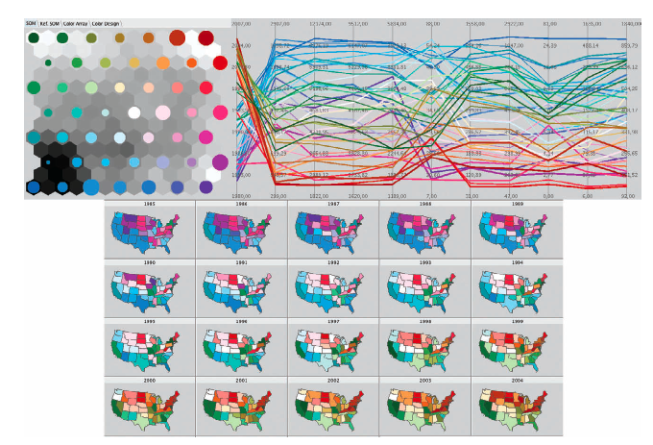

Slide 42
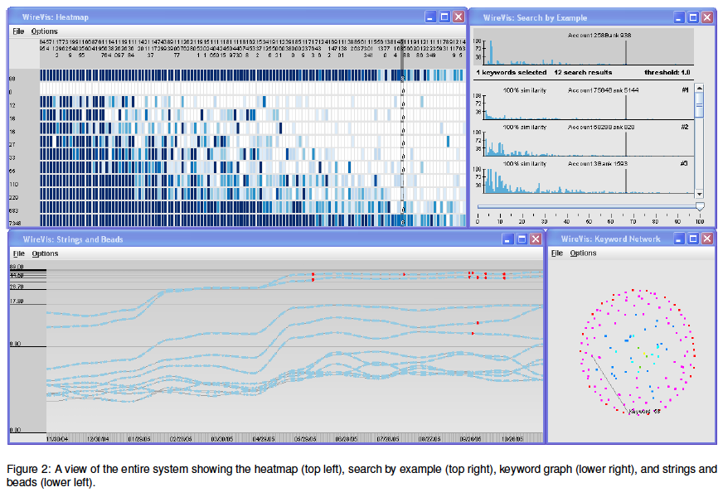
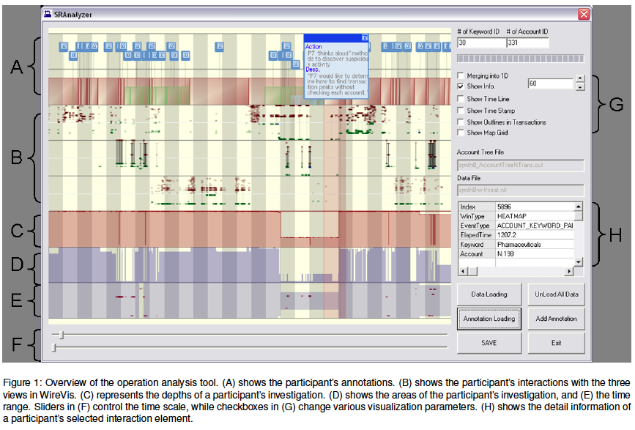
Fraud Detection of Bank Wire Transactions

Slide 43
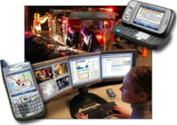
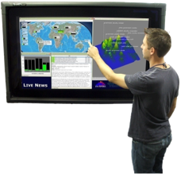
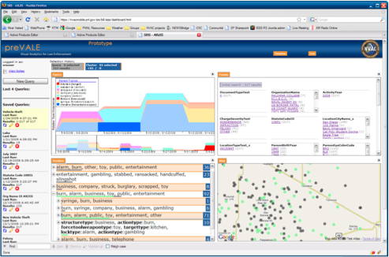
Displays and Views

Slide 44
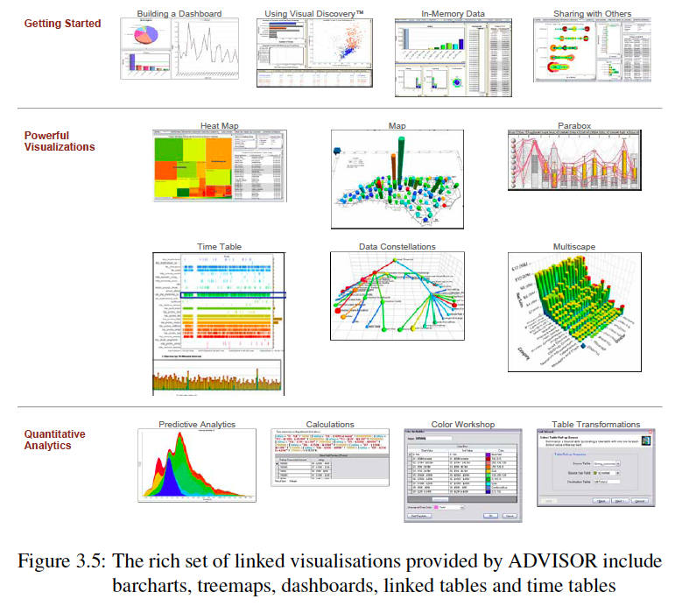
A classical VA tool

Slide 45
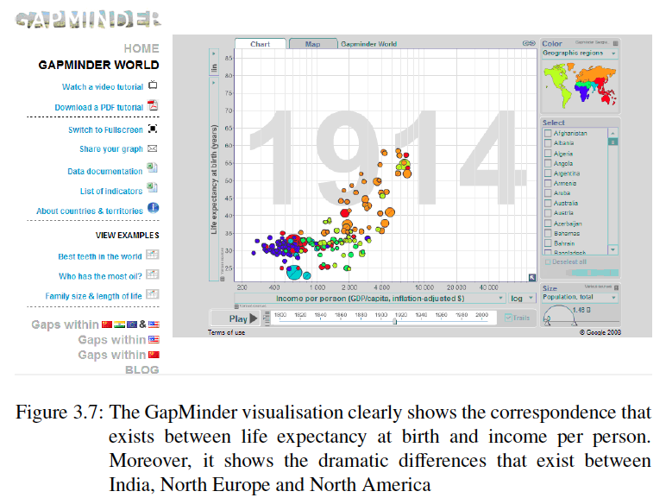
GapMinder [Demo]

Slide 46
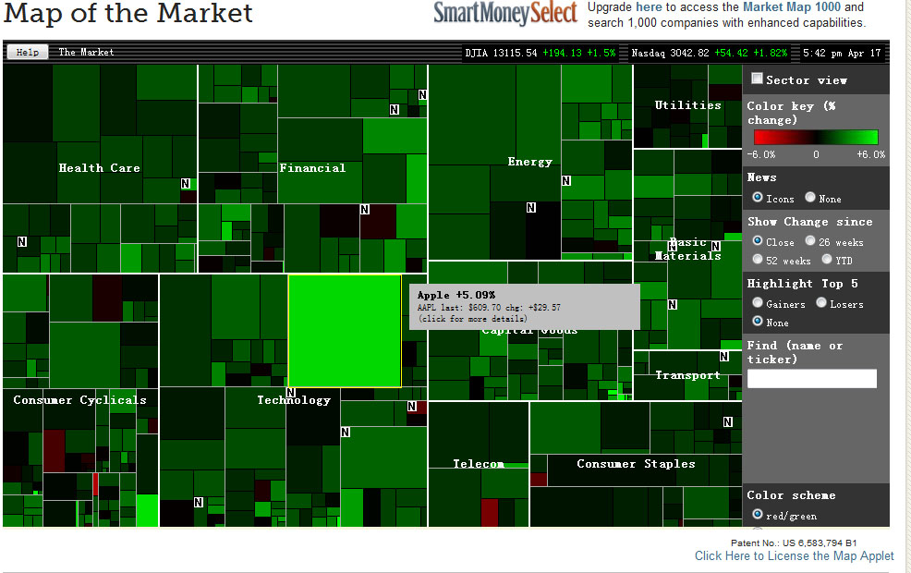
Smart Money Map [Demo]

Slide 47
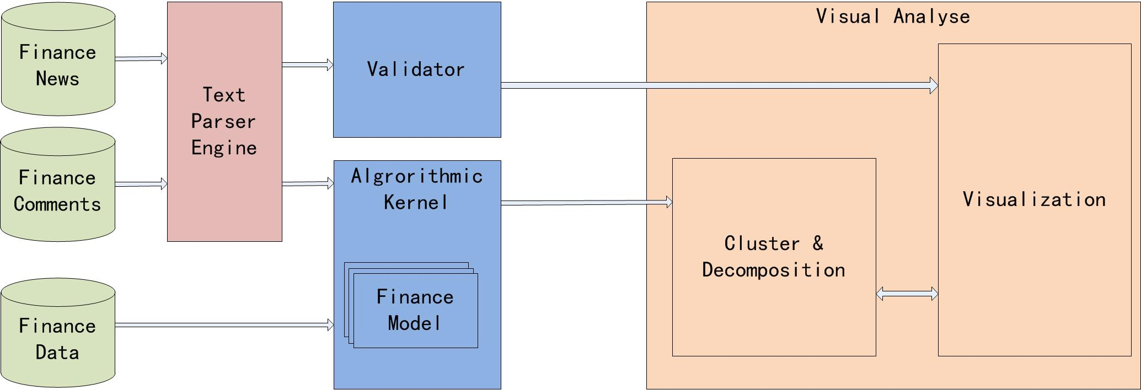
A recent project

Slide 48
Chances and Challenges
The basic techniques for large scale simulation and computing are ready
However, large and time-consuming computing tasks need steering or visualize the intermediate computing results.
Most simulation and computing tasks have to tune hundreds of parameters.
Smart/intelligent data mining/data processing algorithms are ready
However, most data mining algorithms have high computational complexity: N² rather than Nlog(N), or N
How to combine automatic computing(machine) and high-level intelligence to gain insight(Human), and involve human in the computing?

Slide 49
Recent Research Topics
Unified Visual Analytics by Heterogeneous Data Sources(esp. Text)
Structured and semi-structured data fusion framework
Data indexing and similarity rank
Visual analytics for high-dimensional heterogeneous data
Domain Risk Management and Preventive Control by Sensor Data Collection and Data Mining
Sensor techniques
Data Warehouse
Coordinated Views integrate visual analytic techniques
Parallel/Distributed Computing Steering by Parameter Optimization and Visualization
Parameter tuning and computing optimization
Intermediate results visualization and task steering
Markov Chain Monte Carlo(MCMC) Simulation

